Slide 1
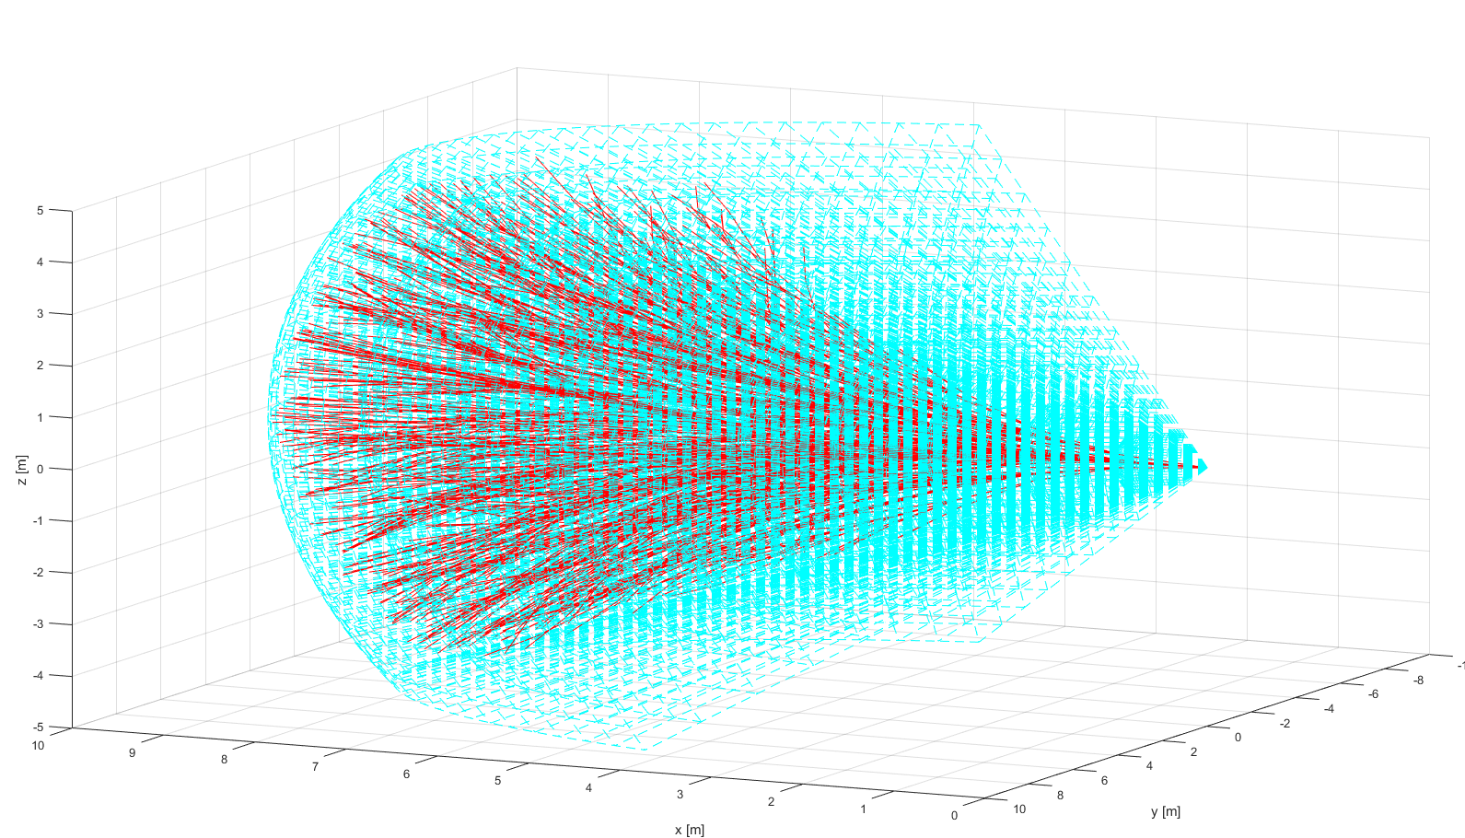
Reach set approximation
ADS-B
Obstacle Map
LiDAR
Rule Engine
Data fusion
Mission Plan
Avoidance grid
UAS model
Movement Automaton
Reach set approximation
Notes:
Example of reach set using my method (red) in Field of vision (aquamarine)
There has been implementation of prototype in Matlab (Deterministic version)

Slide 2
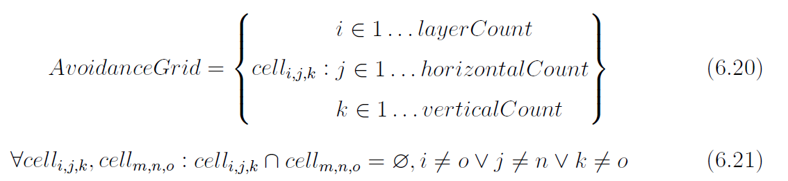
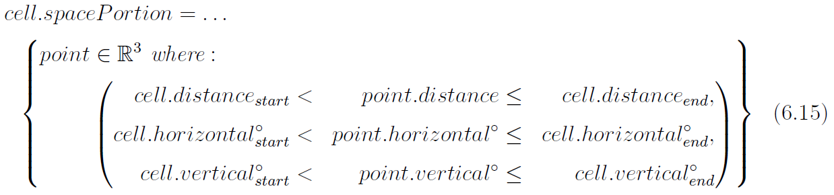
Reach set approximation Space segmentation – Avoidance Grid (6.3)
An intermediate operational space is segmented into avoidance grid:
One cell space portion is bounded by:
Refer to (def. 11,12)

Slide 3
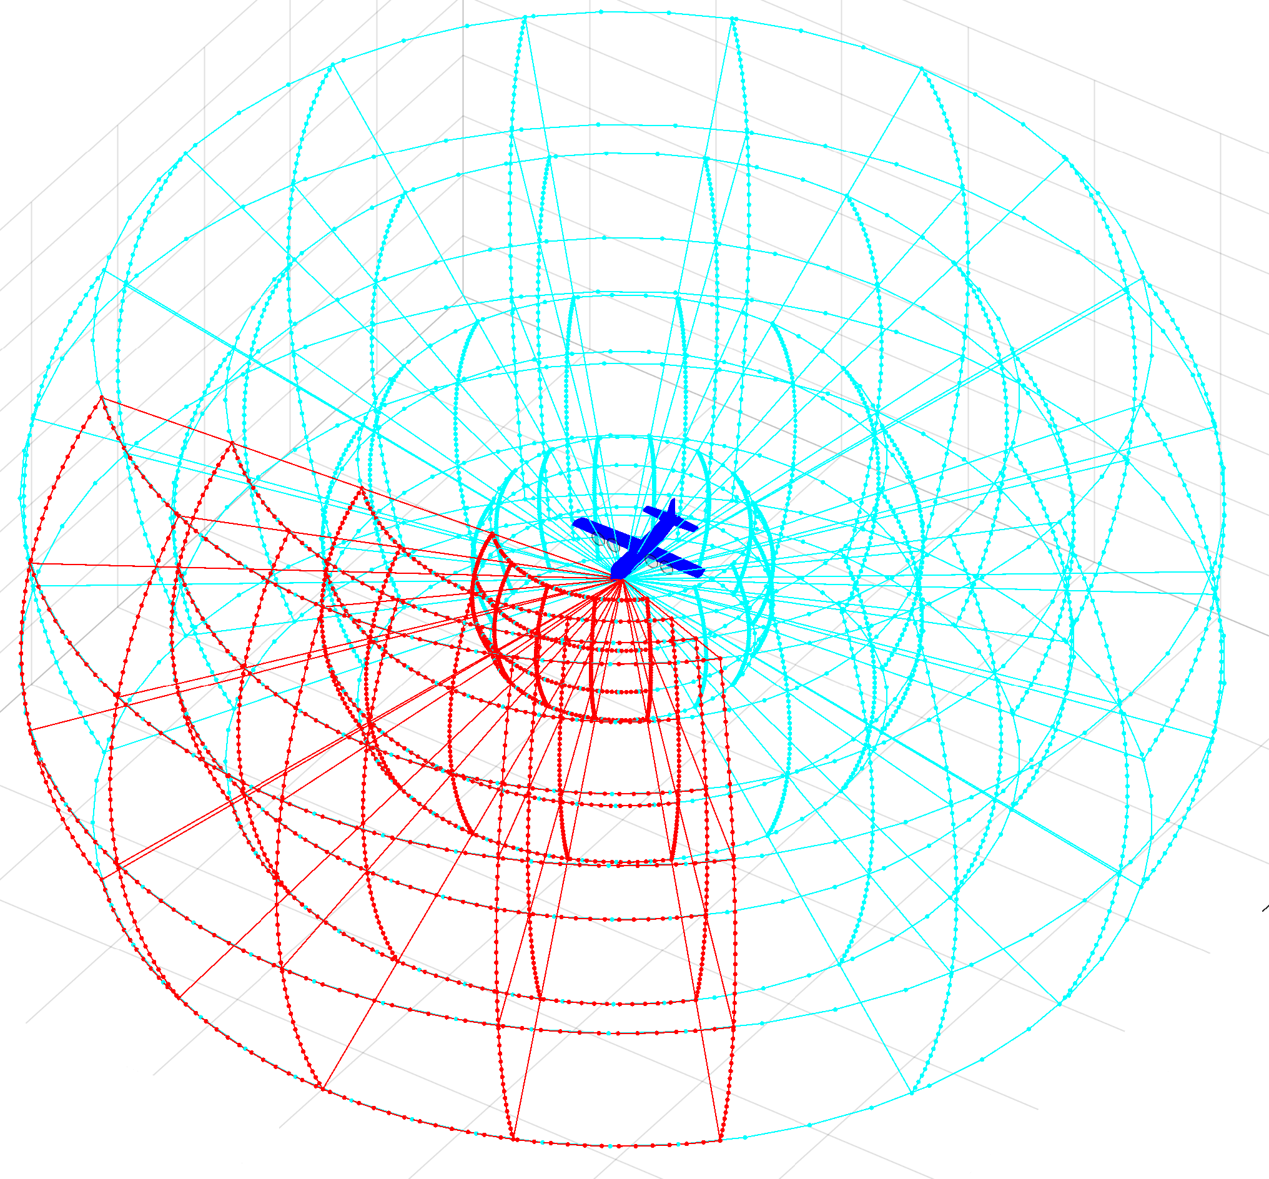
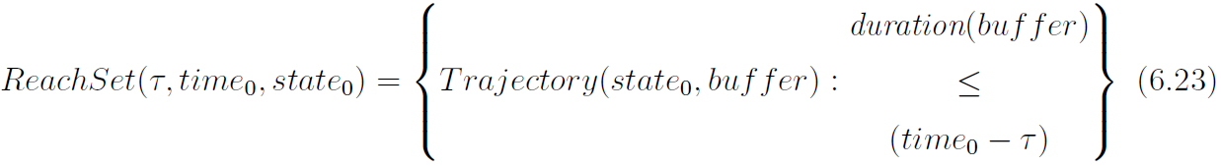
Reach set approximation The RSA definition
In segmented discrete operational space represented as avoidance grid:
The reach set approximation is a set of trajectories with common origin:

Slide 4
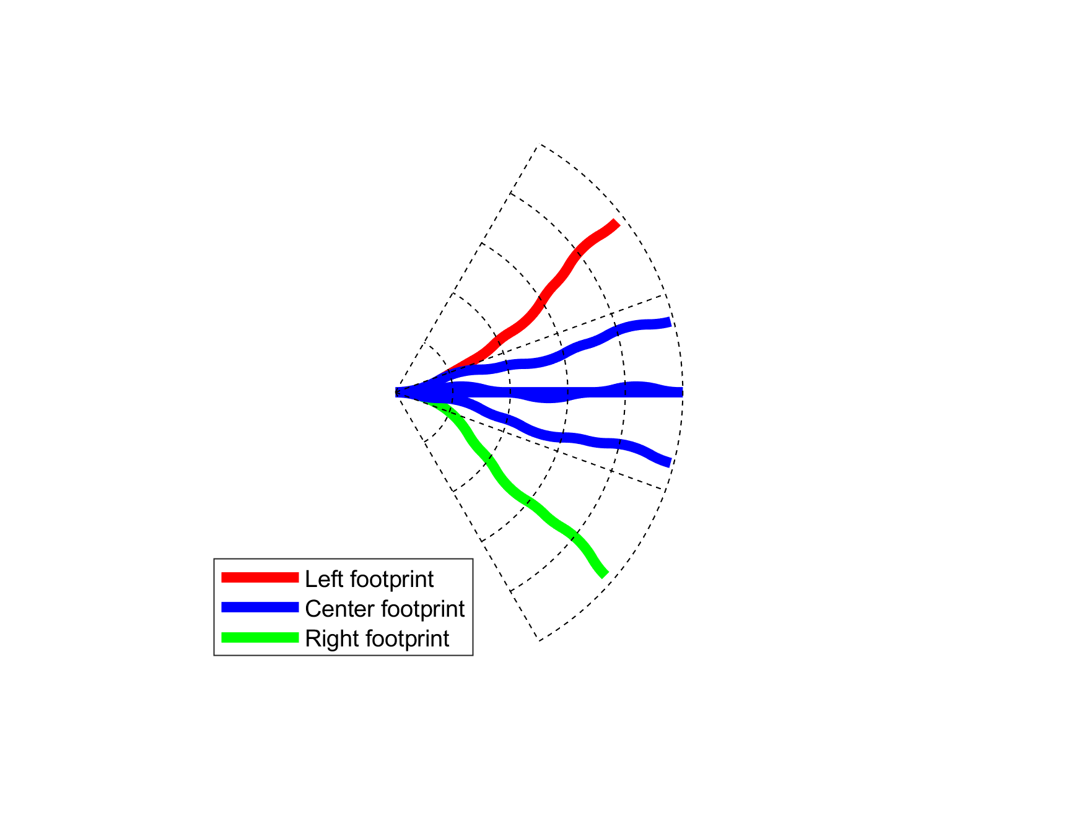
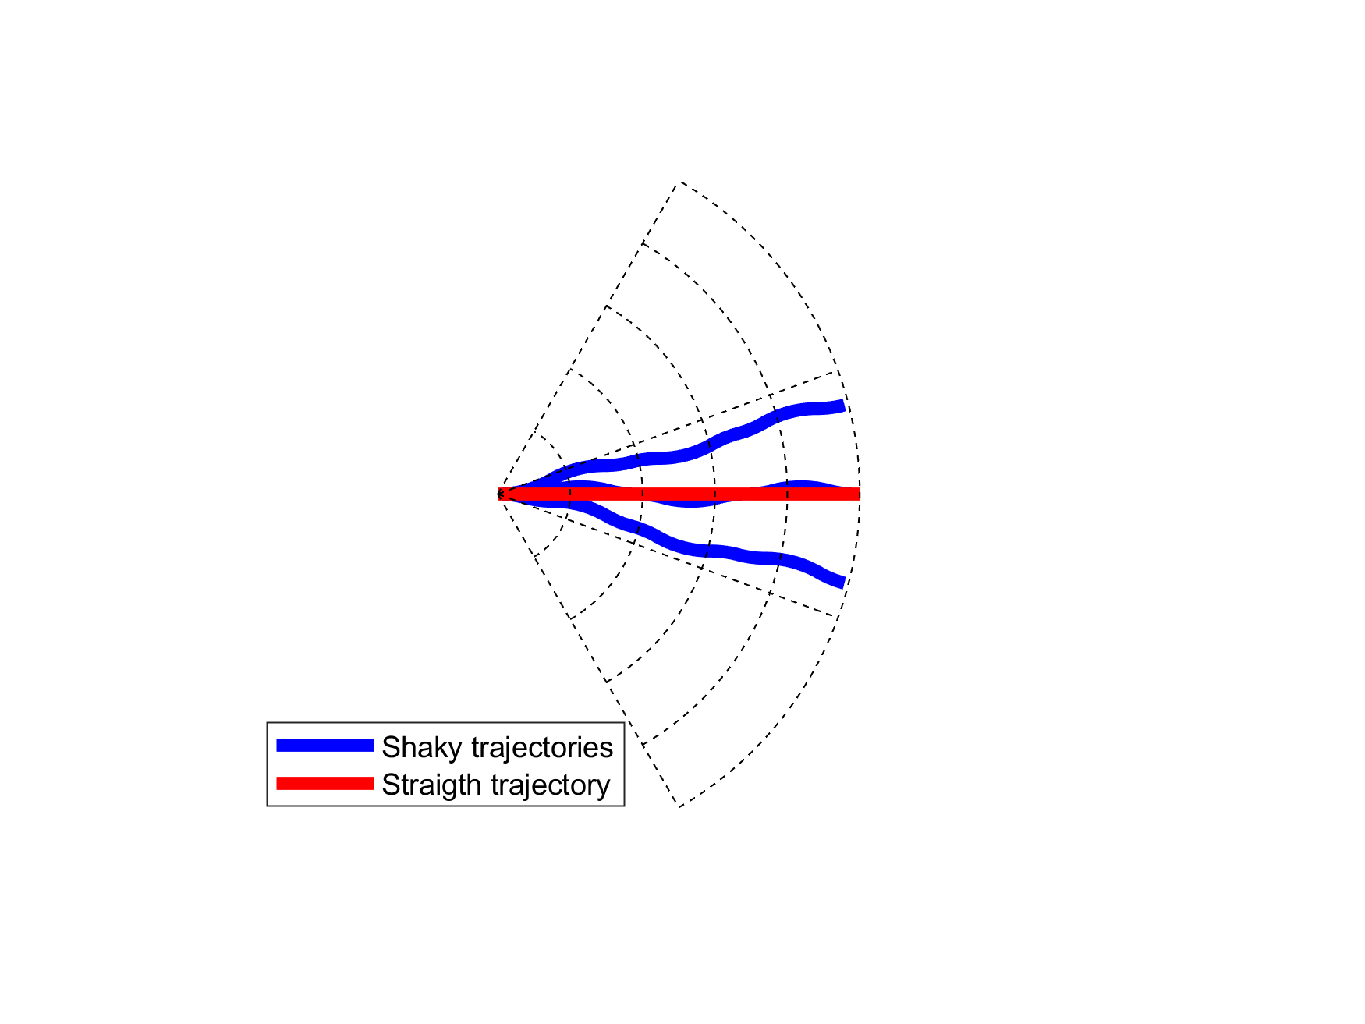
Reach set approximation: Trajectory properties (6.4.2)
Coverage – the trajectory footprint
6 trajectories 3 unique footprints
Turn ratio – count of turning movements
Try to minimize turning in reach set !
Notes:
The reach set is main point of our work, it represents where vehicle can get,
we experimented with GRAPH and TRAJECTORY SET representaitons

Slide 5
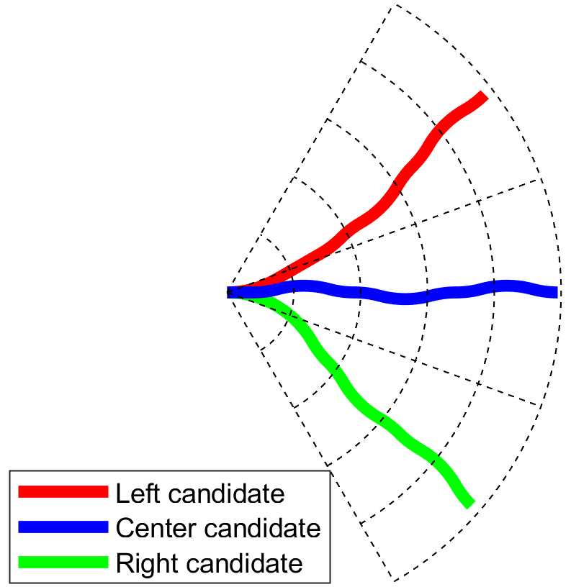
Reach set Approximation Property based approximations (6.4.3)
Get the
minimal
discrete trajectory set (RSA)
covering
all possible maneuvers
Reach set Approximation
Calculation Process (6.4.3)

Slide 6
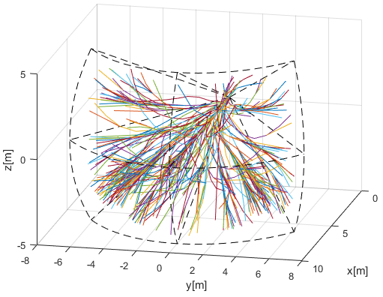
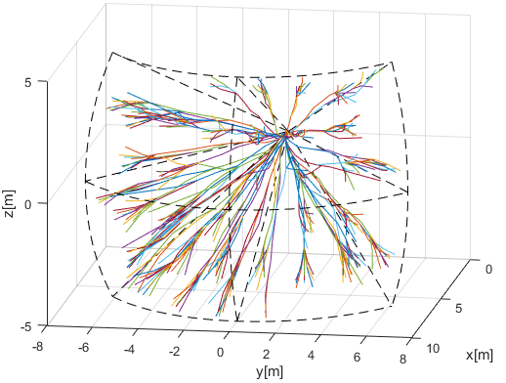
Reach set approximation: Developed Reach set Approximations 1/2
Coverage-maximizing RSA (6.4.4)
Contains trajectories with: high coverage rate
Useful for: intruder/obstacle avoidance
In: Non-controlled airspace
Turn-minimizing RSA (6.4.5)
Contains trajectories with: high smoothness
Useful for: Navigation
In: Non-controlled airspace

Slide 7
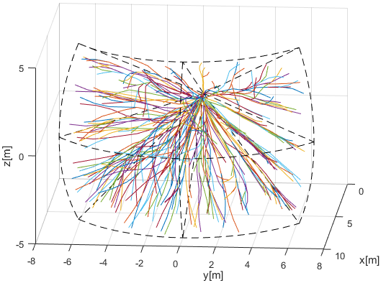
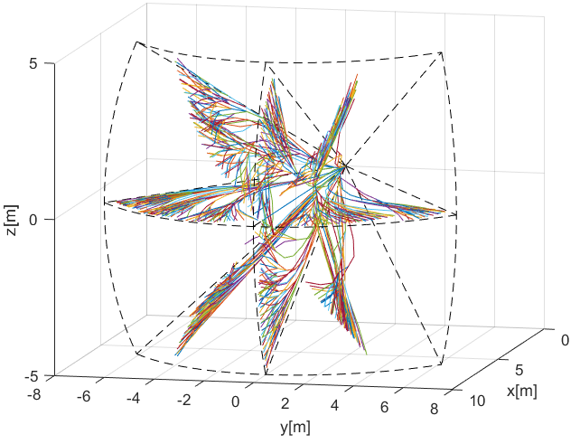
Reach set approximation: Developed Reach set Approximations 2/2
Combined RSA (6.4.7)
Contains trajectories with: TM + CM RSA combination
Useful for: avoidance/navigation
In: Controlled airspace in case of Emergency
ACAS-like RSA (6.4.6)
Contains trajectories with: ACAS behavior
Useful for: Navigation/UTM Resolutions
In: Controlled airspace

